Slide 1
Interfaces nativas Cross-Platform con Xamarin.Forms
Xamarin Dev Days Madrid

Slide 2


Javier Suárez Ruiz
Visual Studio Technologies & Windows Platform Development MVP
Software Developer Plain Concepts
Blog: http://geeks.ms/blogs/jsuarez
Email: javiersuarezruiz@hotmail.com
Twitter: @jsuarezruiz

Slide 3

10% de descuento
En nuestro curso online de:
Usa este cupón en campusMVP.es:
xamarindo
Válido hasta el 31 de Diciembre de 2016
www.campusMVP.es

Slide 4
Conoce Xamarin.Forms
Crear UIs nativas para iOS, Android, y Windows
Desde un mismo archivo común, compartido C#.

Slide 5
Xamarin + Xamarin.Forms
iOS C# UI
Android C# UI
Windows C# UI
Shared UI Code
Shared C# Backend
Shared C# Backend
Enfoque tradicional de Xamarin
Con Xamarin.Forms: Más código compartido, todo nativo

Slide 6
¿Qué se incluye?
✓ 40+ páginas, layouts, y controles
(code behind o XAML)
✓ Two-way data binding
✓ Navegación
✓ API de animaciones
✓ Dependency Service
✓ Messaging Center
Shared UI Code
Shared C# Backend

Slide 7

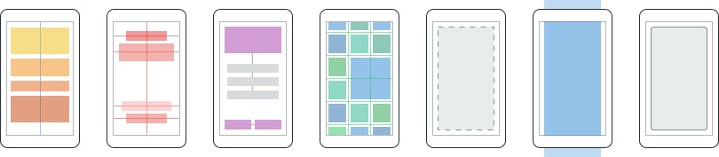
Layouts
Páginas
Content
MasterDetail
Navigation
Tabbed
Carousel
Stack
Absolute
Relative
Grid
ContentView
ScrollView
Frame
Notes:
Inside of a page are layouts
A lot of options from something simple like a stack panel to complex and powerful grids

Slide 8
Controles
ActivityIndicator
BoxView
Button
DatePicker
Editor
Entry
Image
Label
ListView
Map
OpenGLView
Picker
ProgressBar
SearchBar
Slider
Stepper
TableView
TimePicker
WebView
EntryCell
ImageCell
SwitchCell
TextCell
ViewCell
Notes:
You have more than 40 controls, layouts, and pages to mix and match from.
These are all of the controls you have out of the box, you can of course create your own.
What is unique is you get the native control and have access to it.
Consider an Entry Field
On iOS it is mapped to UITextField
Android it is EditText
Windows Phoen it is a TextBox

Slide 9


El ecosistema Xamarin.Forms

Slide 10
Comparativa de controles
Windows | Xamarin.Forms
StackPanel | StackLayout
TextBox | Entry
ListBox | ListView
CheckBox | Switch
ProgressBar | ActivityIndicator
Grid | Grid
Label | Label
Button | Button
Image | Image
Date/TimePicker | Date/TimePicker

Slide 11
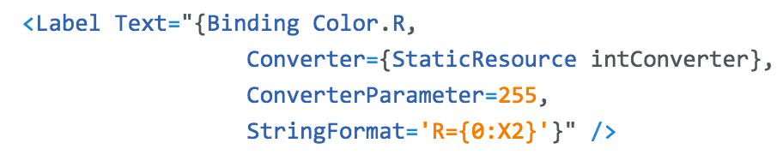
Windows | Xamarin.Forms
DataContext | BindingContext
{Binding Property} | {Binding Property}
ItemsSource | ItemsSource
ItemTemplate | ItemTemplate
DataTemplate | DataTemplate
Comparativa de enlace a datos

Slide 12
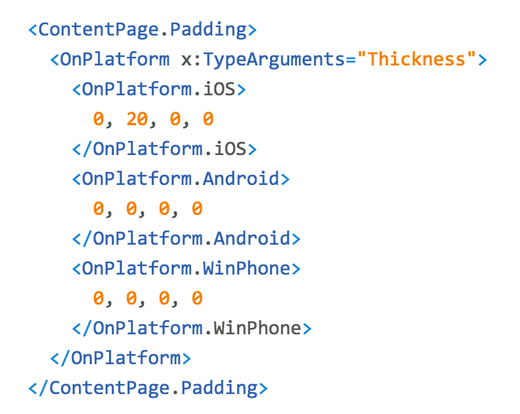
Personalización de la plataforma

Slide 13
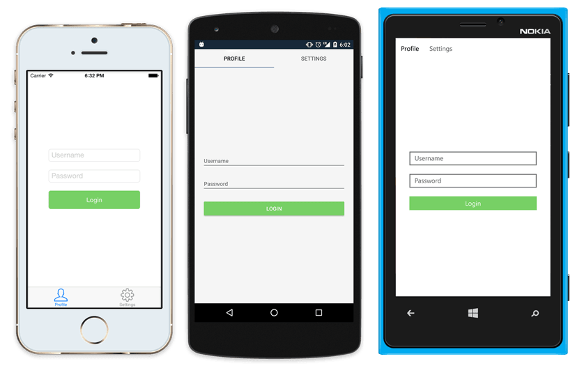
UI Nativa desde código compartido
<?xml version="1.0" encoding="UTF-8"?>
<TabbedPage xmlns="http://xamarin.com/schemas/2014/forms"
xmlns:x="http://schemas.microsoft.com/winfx/2009/xaml"
x:Class="MyApp.MainPage">
<TabbedPage.Children>
<ContentPage Title="Profile" Icon="Profile.png">
<StackLayout Spacing="20" Padding="20"
VerticalOptions="Center">
<Entry Placeholder="Username"
Text="{Binding Username}"/>
<Entry Placeholder="Password"
Text="{Binding Password}"
IsPassword="true"/>
<Button Text="Login" TextColor="White"
BackgroundColor="#77D065"
Command="{Binding LoginCommand}"/>
</StackLayout>
</ContentPage>
<ContentPage Title="Settings" Icon="Settings.png">
<!-- Settings -->
</ContentPage>
</TabbedPage.Children>
</TabbedPage>

Slide 14
Xamarin.Forms Demo

Slide 15
¿Qué hay nuevo? Xamarin.Forms 2.0!

Slide 16
Xamarin.Forms es Open Source!
open.xamarin.com
Notes:
Apple has a developer preview where Xamarin has alphas ready. Google does not offer this.
Android versions are usually 4 to 8 weeks out for a stable release, but alphas and betas are usually earlier.
Xamarin realizes how important having iOS ready because within 24 hours a large portion of iOS users upgrade
Android on the other hand is much different. After 4 months on the market Android 4.4 only had 1% adoption

Slide 17
Rendimiento Rendimiento Rendimiento

Slide 18
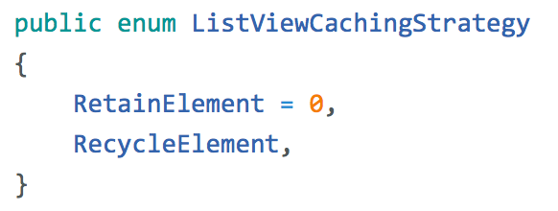
ListView CachingStrategy
✓ Mejora el rendimiendo haciendo scroll
✓ El comportamiento antiguo es el usado por defecto

Slide 19
Compilación XAML
XAML
XAMLC
Compile-time
Parsed & turned into IL
Runtime
Parsed and inflated

Slide 20
Beneficios
✓ Carga más rapida
✓ Tamaño de la App menor
✓ Ver errores XAML en tiempo de compilación

Slide 21
Rendimiento Demo

Slide 22
Diseño & Controles

Slide 23
Data Templates

Slide 24
Data Templates Demo

Slide 25
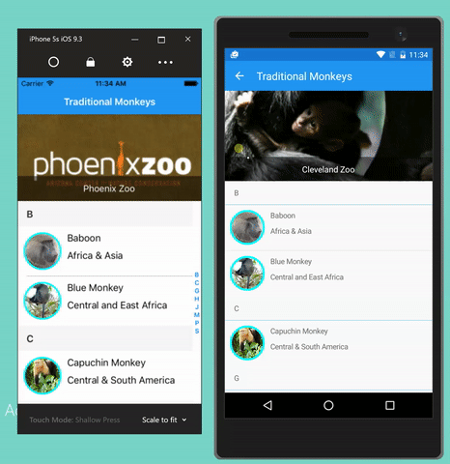
CarouselView
Carousel
ItemTemplate & DataTemplates
Altamente personalizable & Virtualizado

Slide 26
CarouselView Demo

Slide 27
Efectos I
✓ Custom renderer “lite”
✓ Cambia propiedades en el control nativo
✓ Opcional
✓ “stringly-typed”
X No métodos o eventos
X No reemplaza el control
Notes:
A unique aspect of Xamarin.Forms is an abstraction over the user interface, but what about the platform specific functionality that makes these devices so special?
That is where plugins for Xamarin come in.

Slide 28
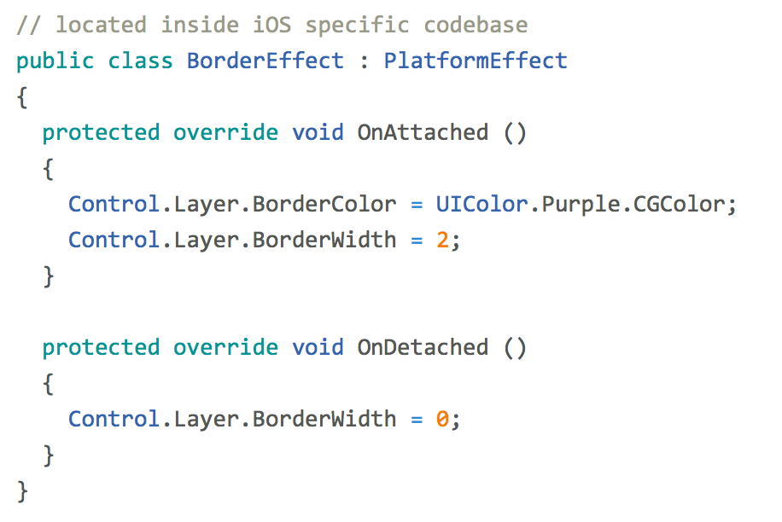
Efectos II
entry.Effects.Add (Effect.Resolve("Xamarin.BorderEffect"));
Notes:
A unique aspect of Xamarin.Forms is an abstraction over the user interface, but what about the platform specific functionality that makes these devices so special?
That is where plugins for Xamarin come in.

Slide 29
Efectos Demo

Slide 30
Y mucho más!

Slide 31
XAML Previewer

Slide 32
Xamarin.Forms Previewer Demo

Slide 33
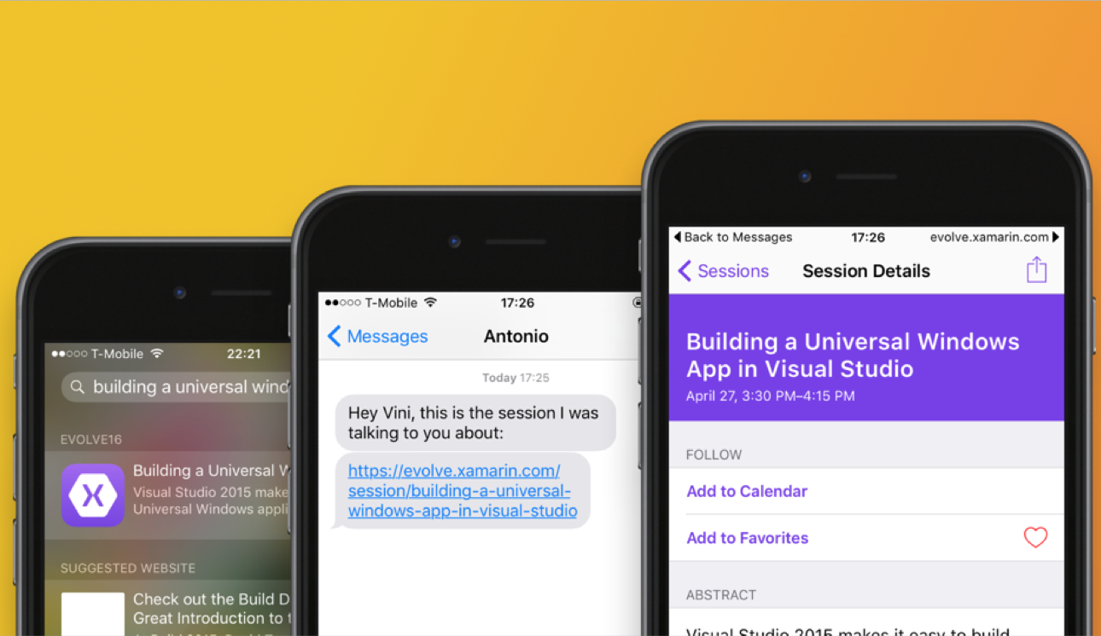
Navegación por URL
Notes:
Connect Web to Mobile
Simple cross platform API over:
CoreSpotlight
NSUserActivity
Google App Indexing

Slide 34
Navegación por URL Demo

Slide 35
Themes
https://developer.xamarin.com/guides/xamarin-forms/themes/

Slide 36
DataPages
https://developer.xamarin.com/guides/xamarin-forms/datapages/

Slide 37
DataPages Demo

Slide 38
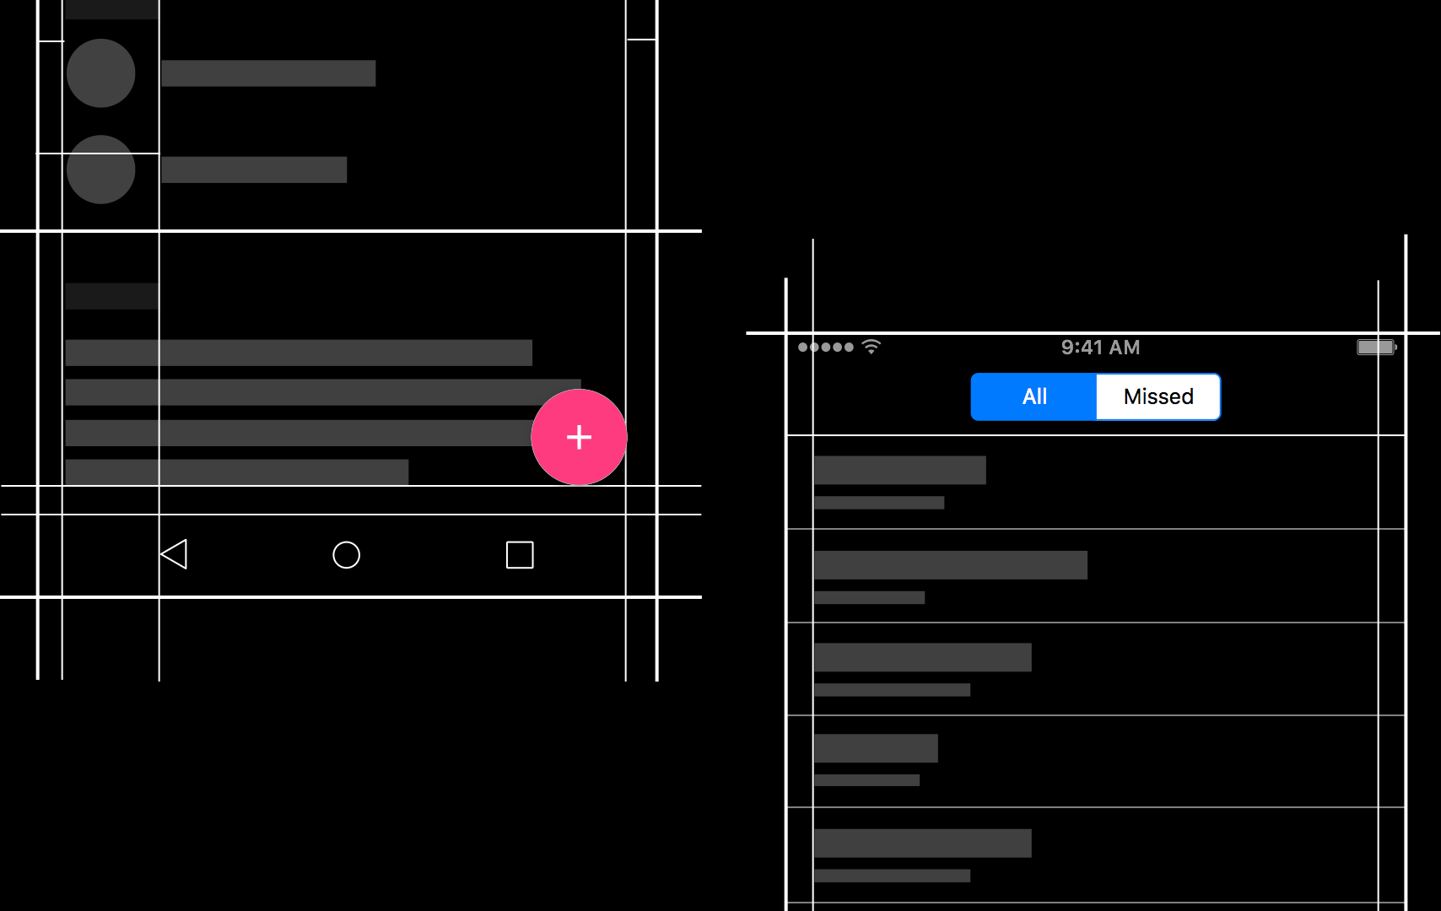
Native Embedding
Notes:
Easily embed any native control into a Xamarin.Forms layout.

Slide 39
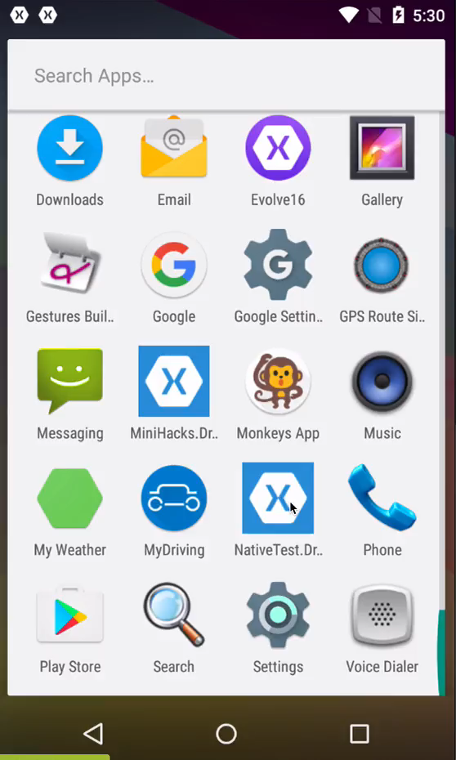
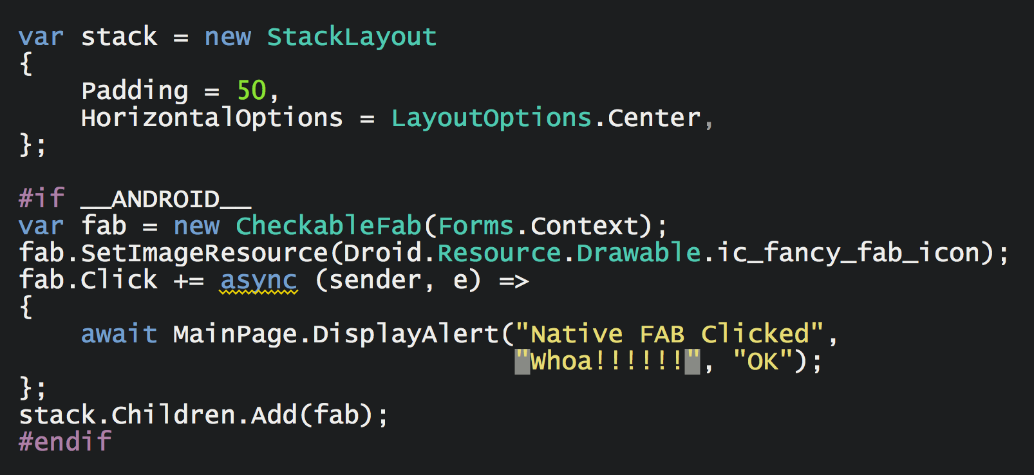
Native Embedding
Notes:
Just add it as child to a layout.
Exposed as an Extension Method.

Slide 40
Native Embedding Demo

Slide 41
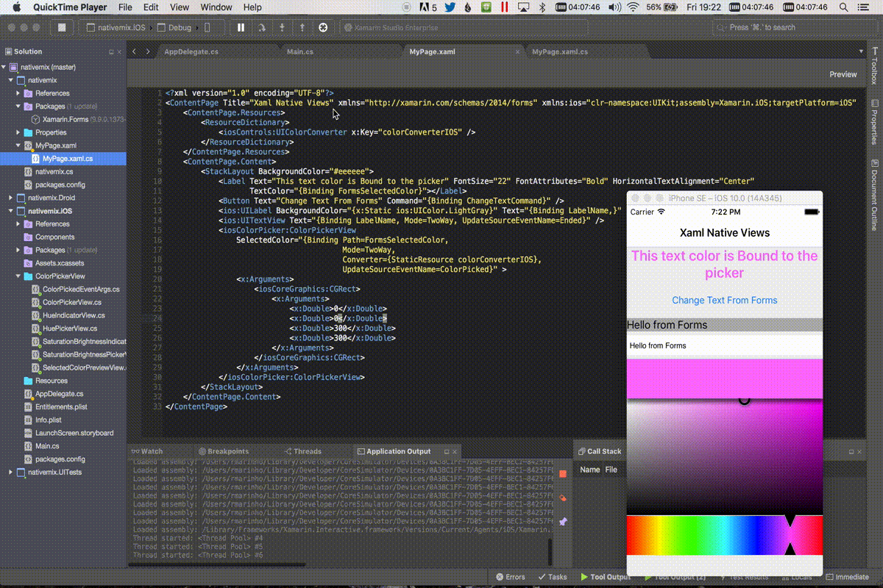
Native Views
Añadir vistas nativas directamente en XAML.
Notes:
Just add it as child to a layout.
Exposed as an Extension Method.

Slide 42
Native Views Demo

Slide 43
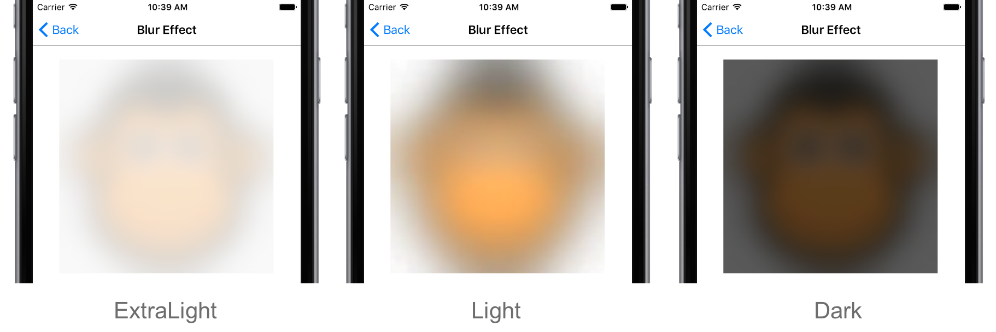
Platform Specifics
using Xamarin.Forms.PlatformConfiguration; using Xamarin.Forms.PlatformConfiguration.iOSSpecific; ... boxView.On<iOS>().UseBlurEffect(BlurEffectStyle.ExtraLight);
Permiten ejecutar características específicas de una plataforma sin necesidad de custom renders o efectos.
Notes:
Just add it as child to a layout.
Exposed as an Extension Method.

Slide 44
Platform Specifics Demo

Slide 45
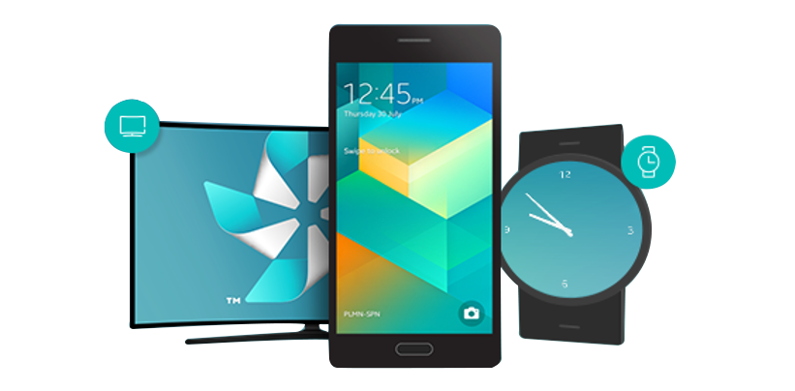
Tizen .NET
Developer Preview
Desarrollado por Samsung
Basado en OSS .NET Core
Se utiliza Xamarin.Forms
www.aka.ms/tizen

Slide 46
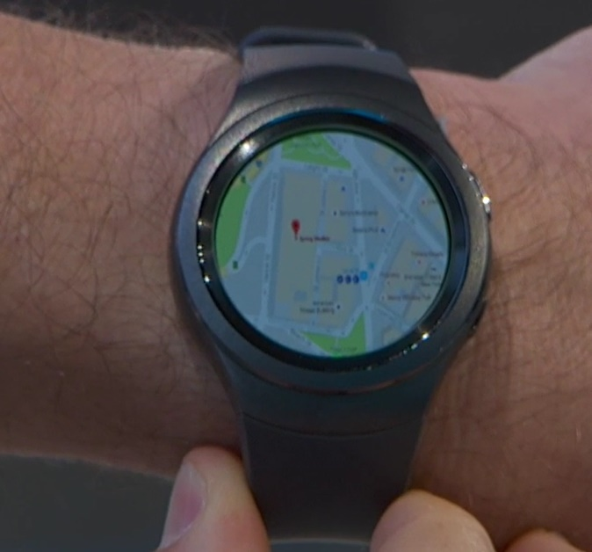
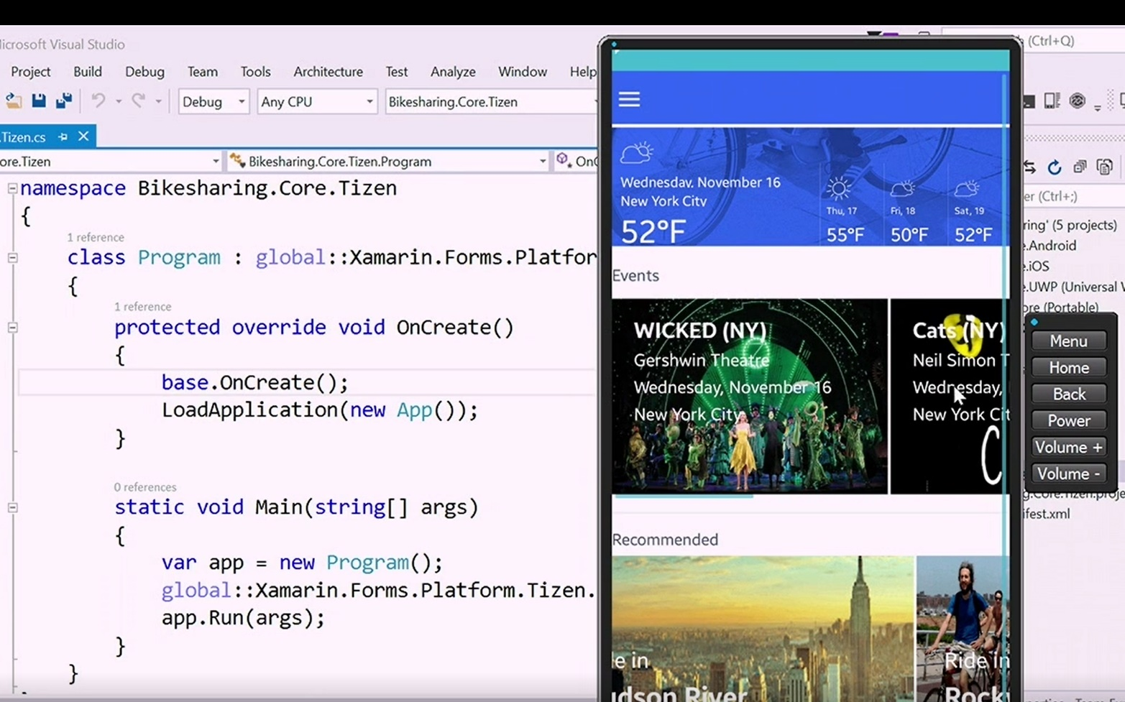
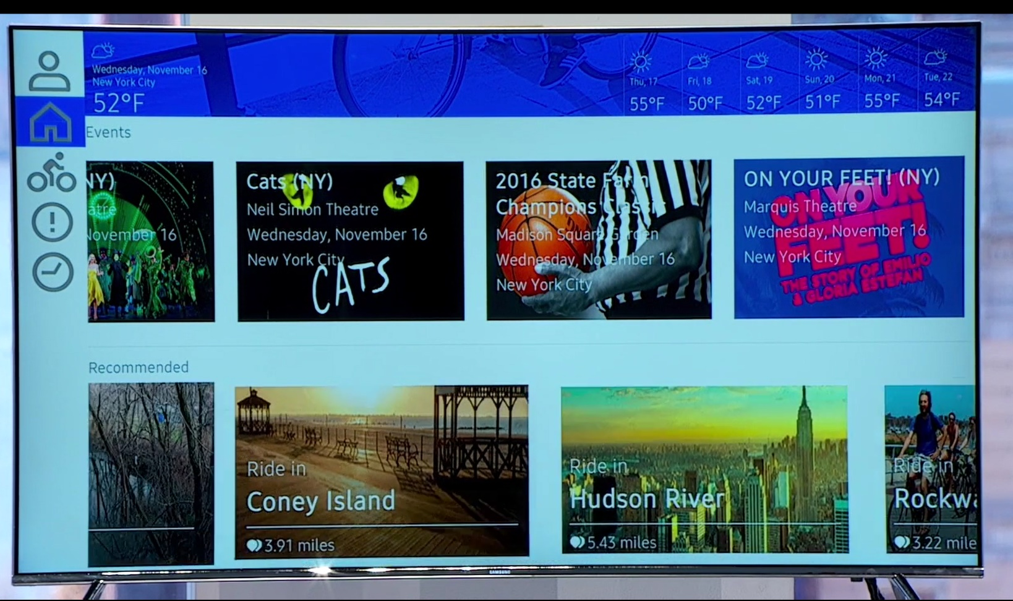
Tizen .NET Developer Preview
Extensión para VS 2017
Plantillas y emulador
Corre en más de 50 mill. de dispositivos

Slide 47
Tizen Demo

Slide 48
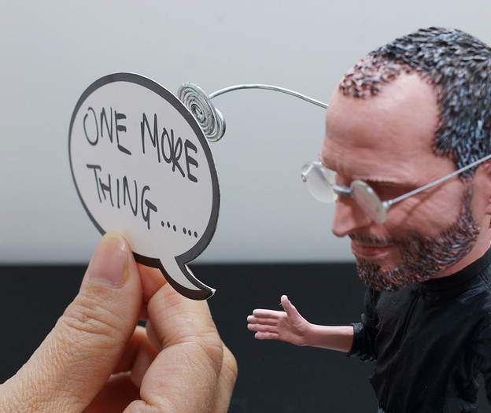
One more thing…

Slide 49
10 Minutos de descanso
Javier
Suárez Ruiz
javiersuarezruiz@hotmail.com
https://javiersuarezruiz.wordpress.com
@jsuarezruiz

